Slide 1



Financial Results FY2020

Slide 2

FY 2020 – FINANCIAL SUMMARY
Detail
Detail

Slide 3

FY2020 – SALES VOLUME
Back
Industry Analysis
Segmented Sales Volume

Slide 4
FY2020 – SEGMENTED SALES VOLUME
Back

Slide 5
FY2020 – INDUSTRY ANALYSIS
Back

Slide 6



FY2020 NET SALES
Back
 | FY - 2020 | FY - 2019 | Column2 | CHANGE
 |  |  | AMOUNT | RATIO
AUTOMOBILE | 73,808 | 112,995 | (39,187) | -34.7%
MOTORCYCLE | 2,912 | 3,554 | (642) | -18.1%
TOTAL | 76,720 | 116,549 | (39,829) | -34.2%
Sales Variance Analysis – AMD
Sales Variance Analysis – MCD
Sales Variance Analysis – Total

Slide 7
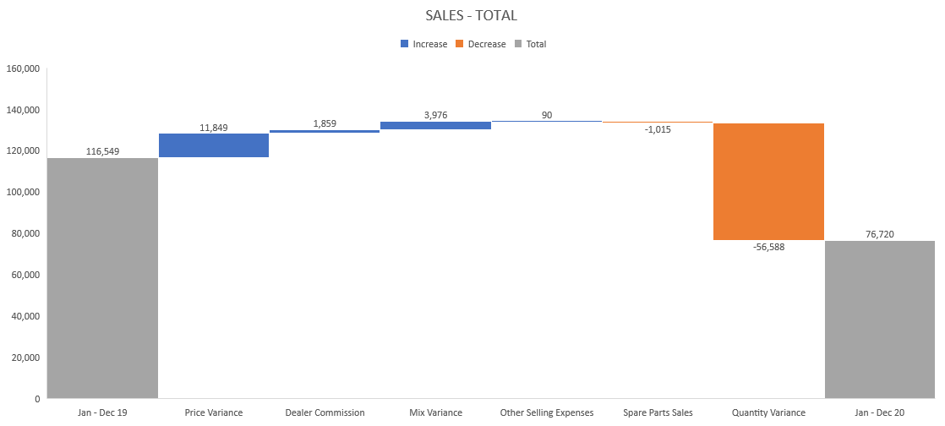
FY2020 – TOTAL SALES
Back

Slide 8
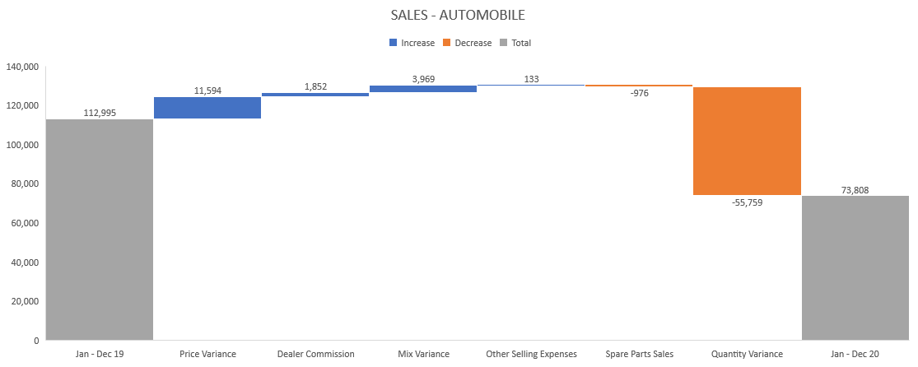
FY2020 – AUTOMOBILE SALES
Back

Slide 9
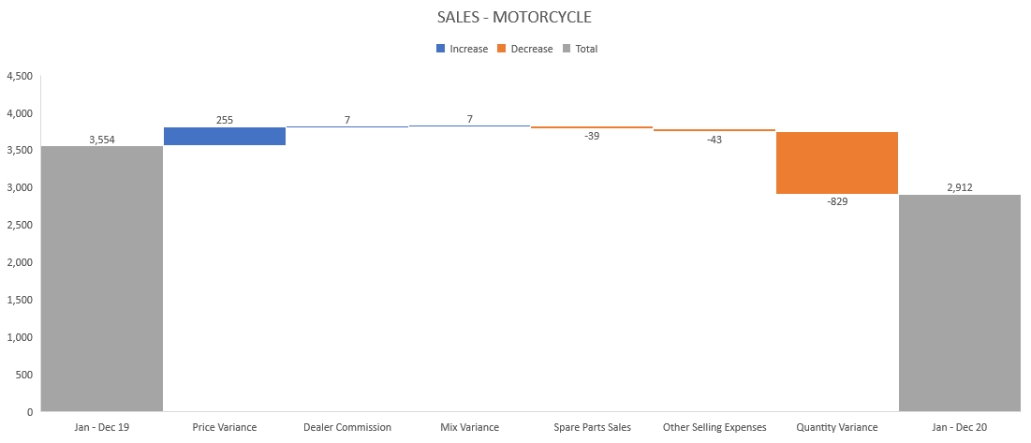
FY2020 – MOTORCYCLE SALES
Back

