Slide 1



Financial Results
FINANCIAL YEAR
2021

Slide 2

FY 2021 – FINANCIAL SUMMARY
Detail
Detail

Slide 3
FY2021 – SALES VOLUME
Back
Segmented Sales

Slide 4
FY2021 – SEGMENTED SALES VOLUME
Back

Slide 5

FY2021 TOTAL SALES
Back
Column1 | FY - 2021 | FY - 2020 | Column2 | CHANGE
 |  |  | AMOUNT | RATIO
AUTOMOBILE | 154,313 | 73,870 | 80,443 | 109%
MOTORCYCLE | 5,766 | 2,912 | 2,854 | 98%
TOTAL | 160,079 | 76,782 | 83,297 | 108%
Sales Variance Analysis – Total

Slide 6
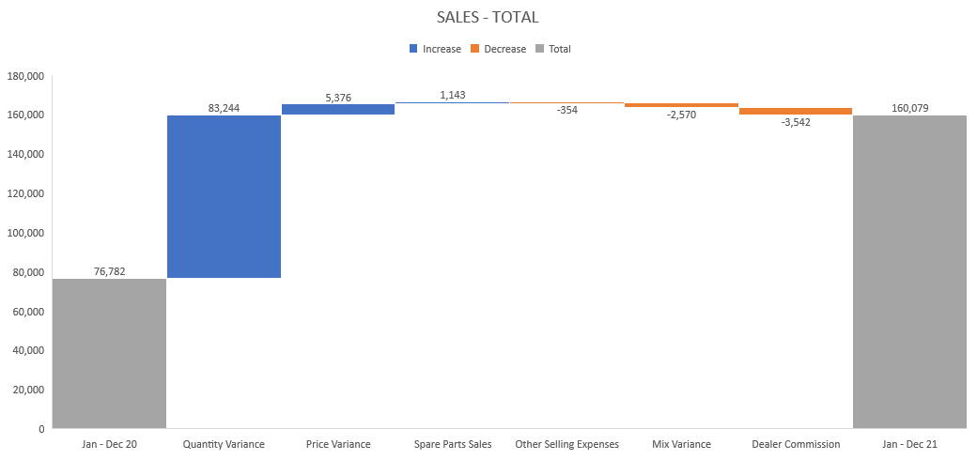
FY2021 – MOTORCYCLE SALES
Back

